Slide 1
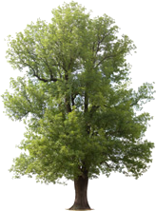
Using Mobile GIS Applications for Early Detection of the Emerald Ash Borer (Agrillus planipennis Fairmaire) in Minnesota
By Caleb Mackey
Notes:
[Introductions]
To understand the need for an application which tracks the Emerald Ash Borer, you first need to understand what the Emerald Ash Borer is and the threat it boses.
ADVANCE

Slide 2
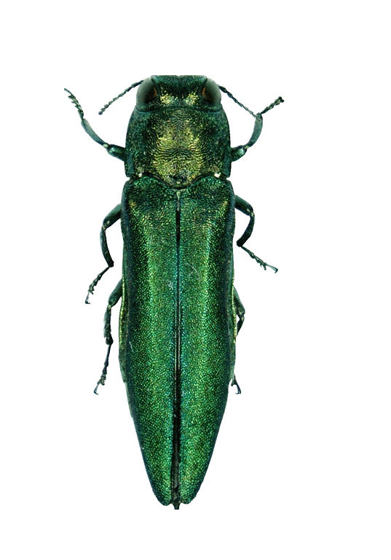
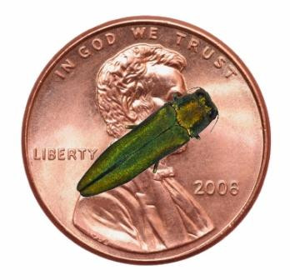
Emerald Ash Borer (Agrilus planipennis)
Exotic beetle from Asia
Member of the Buprestidae (wood-boring beetle) family
1-2 Year life cycle
Larvae eat inner bark disrupting water and nutrient transport
Killed millions of Ash trees in North America
Responsible for billions of dollars of damage
10mm
2 mm
Notes:
The EAB is a small beetle belonging to the Buprestidae or wood-boring family of beetles and are usually less than 10 mm long and 2 mm wide.
They are a metallic green color and have a bullet shaped body.
The native host range of the EAB is the southeast region of Asia including areas of Japan, China, Taiwan, Mongolia, and eastern Russia. In their host range, the EAB attacks mostly Asian ash species at low densities as a secondary pest and are generally more attracted to the stressed trees or trees with declining health (Anulewicz et al. 2006).
This beetle usually has a one to two year cycle in North America and are most active during the months of May-September.
The EAB will go through a 2 week period of maturation under the bark of ash trees by eating foliage before laying their eggs there.
Once the larvae hatch, they begin to bore through the bark and into the cambium area of the tree, forming S-shaped burrows that can severely damage the trees (Marshall 2010).

Slide 3
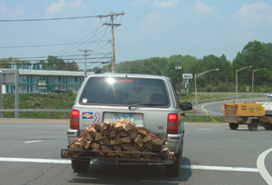
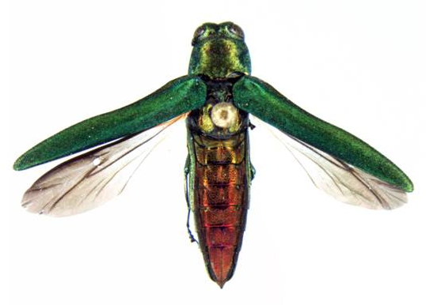
Dispersal in North America
First discovered in North America in the Detroit, MI area in 2002, though it had likely been here since the late 1990’s.
They usually only fly about 0.5km from their host tree
Most of their movement is from humans unknowingly transporting larvae in firewood.
Larvae can stay in the wood for up to 2 years

Slide 4
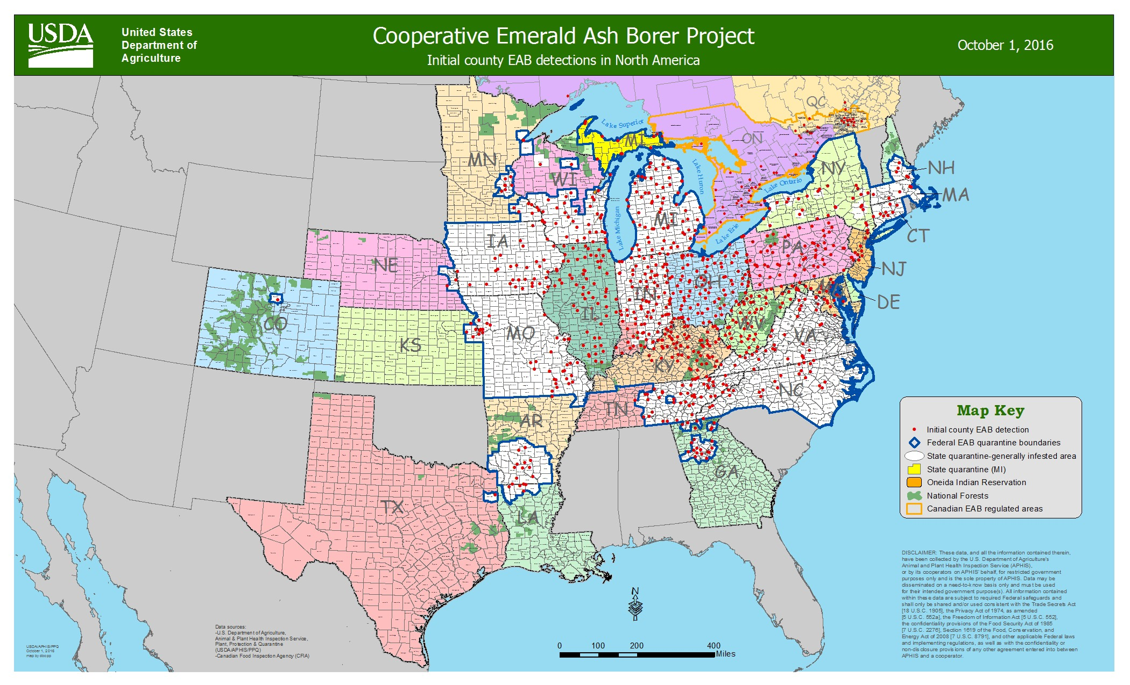

Slide 5
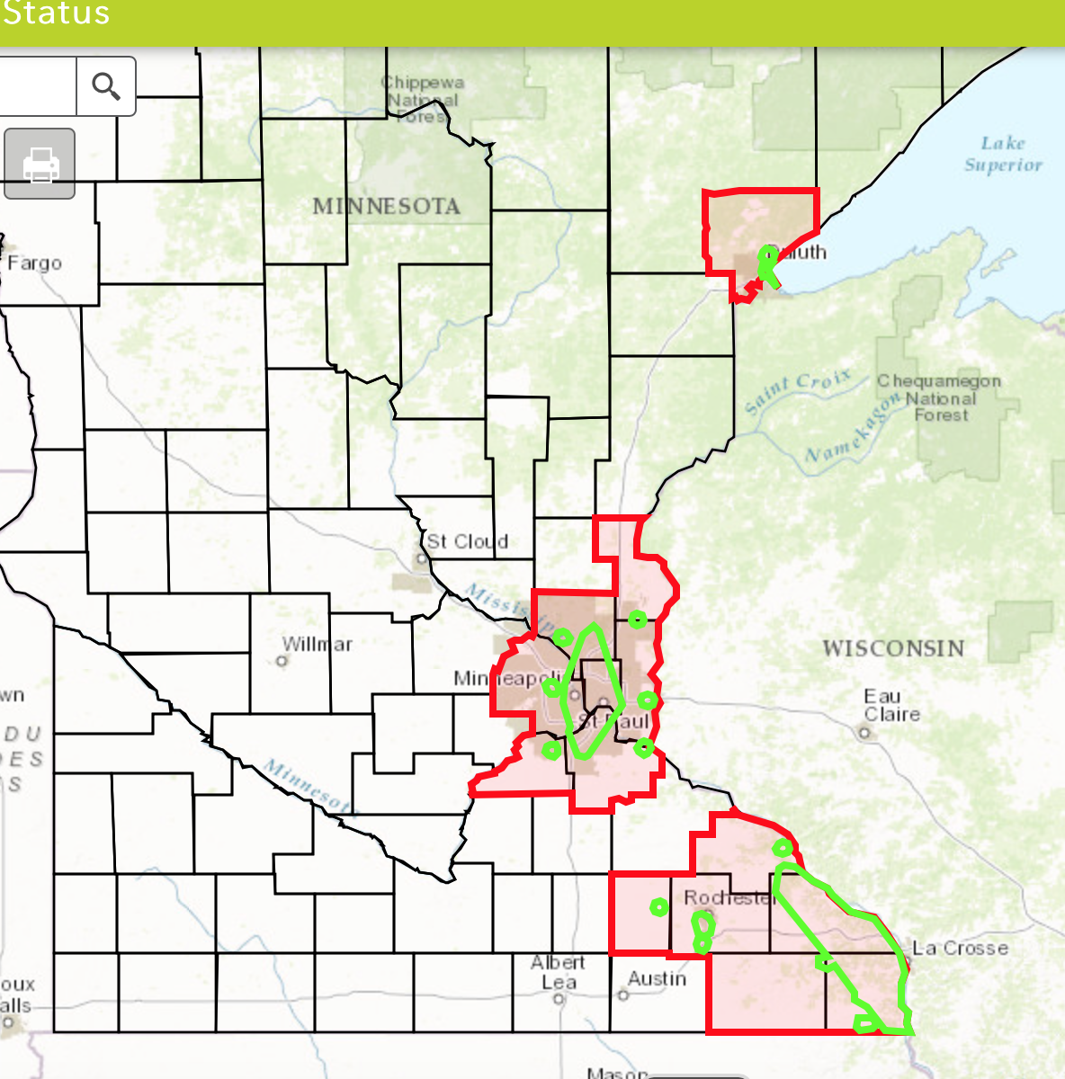
EAB Distribution in Minnesota

Slide 6
EAB Battle in St. Paul
First reported sightings in 2009
~26,000 ash in public ROW, tens of thousands more in city parks
2015 – EAB city wide coverage went from 55-75%
Up from 3.5% in 2010!
Tree removal and replacement program
Private property tree removal is the responsibility of landowner
Expensive!
Notes:
Dead and Dying trees need to be replaced because branches become weak and fall on cars etc
USE BELOW FOR PROPOSAL ONLY
6,190 trees removed from public ROW through structured removal plan
Tree replacement: goal is to replace each ash tree with a tree from a different species.
Tree prices have gone up, in 2010 a hackberry was $155, now up to $285 to install
$150k budget only covers 968 in 2010, only 526 can be purchased with same budget in 2016
Treatment: 1,922 to date
Tree replacement can cost a landowner between $459 to $651 depending on the size and distance to power lines in the Minneapolis area

Slide 7
Tracking the EAB in Minnesota
The Minnesota Department of Agriculture (MDA) is the lead agency in Minnesota for monitoring the movements of the EAB.
Insect trapping
Field inspections in high risk areas
Rely on visual cues
Crown dieback
Epicormic sprouts
D – Shaped Exit holes
Bark splitting / visible larval galleries
Woodpecker flecking
They peel back the bark to search for larvae

Slide 8
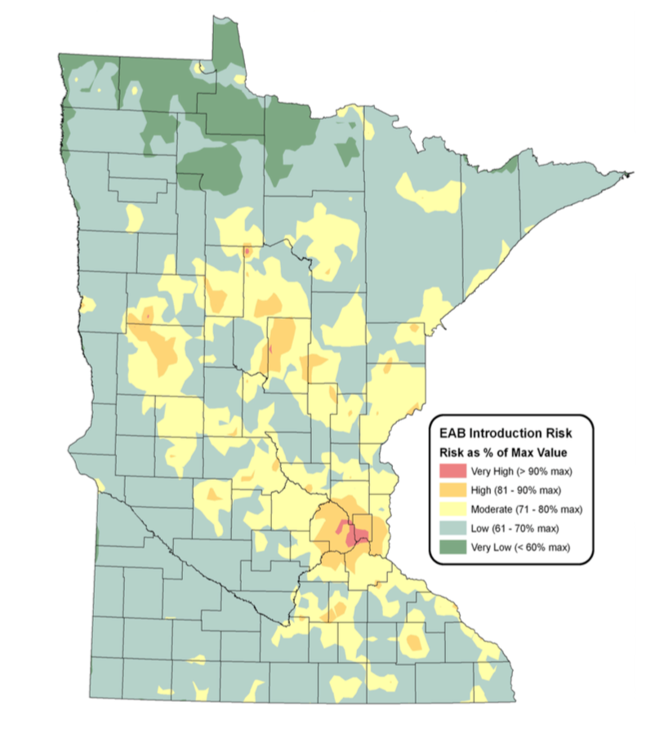
EAB Risk Map
Notes:
This map was created by the MDA in 2006 based on ash population densities, campgrounds, sawmills, tree nurseries, and urban areas

Slide 9
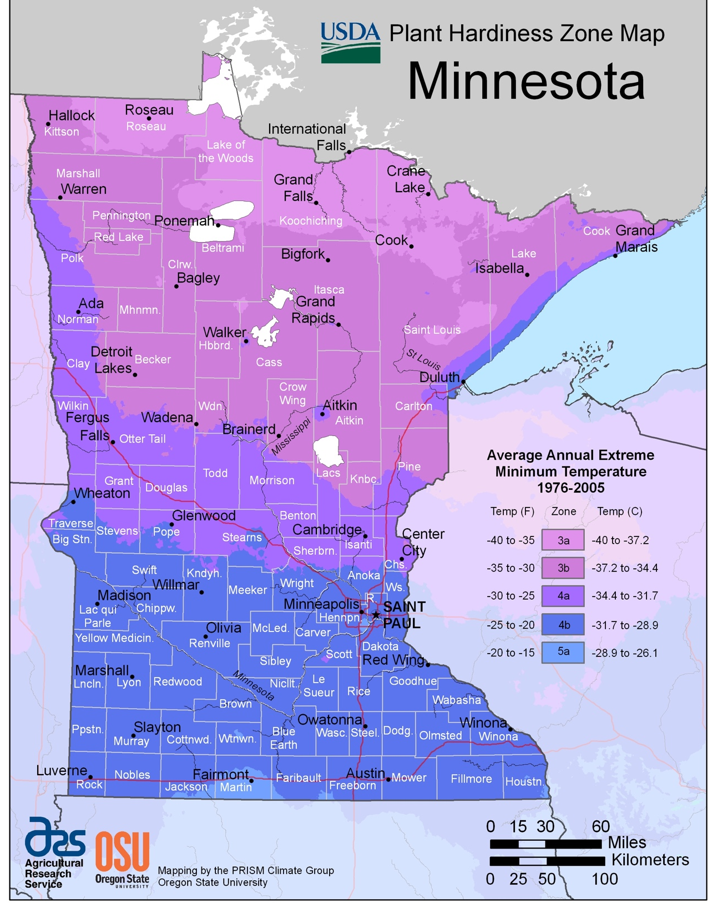
There are areas in northern Minnesota where winters are too harsh for EAB larvae to survive
50% mortality when temps are -20°F to -30°F.
90% mortality when temps fall under -30°F
Notes:
EAB Risk map does not account for cold temps up north
50% mortality when temps are -20 to -30 for a extended period of time
90% when temps < -30

Slide 10
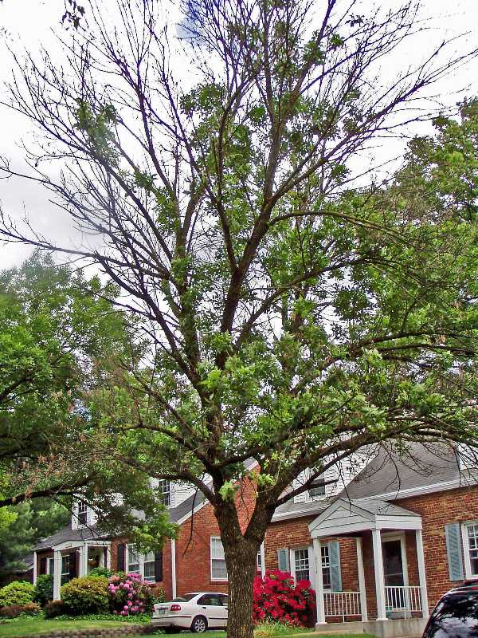

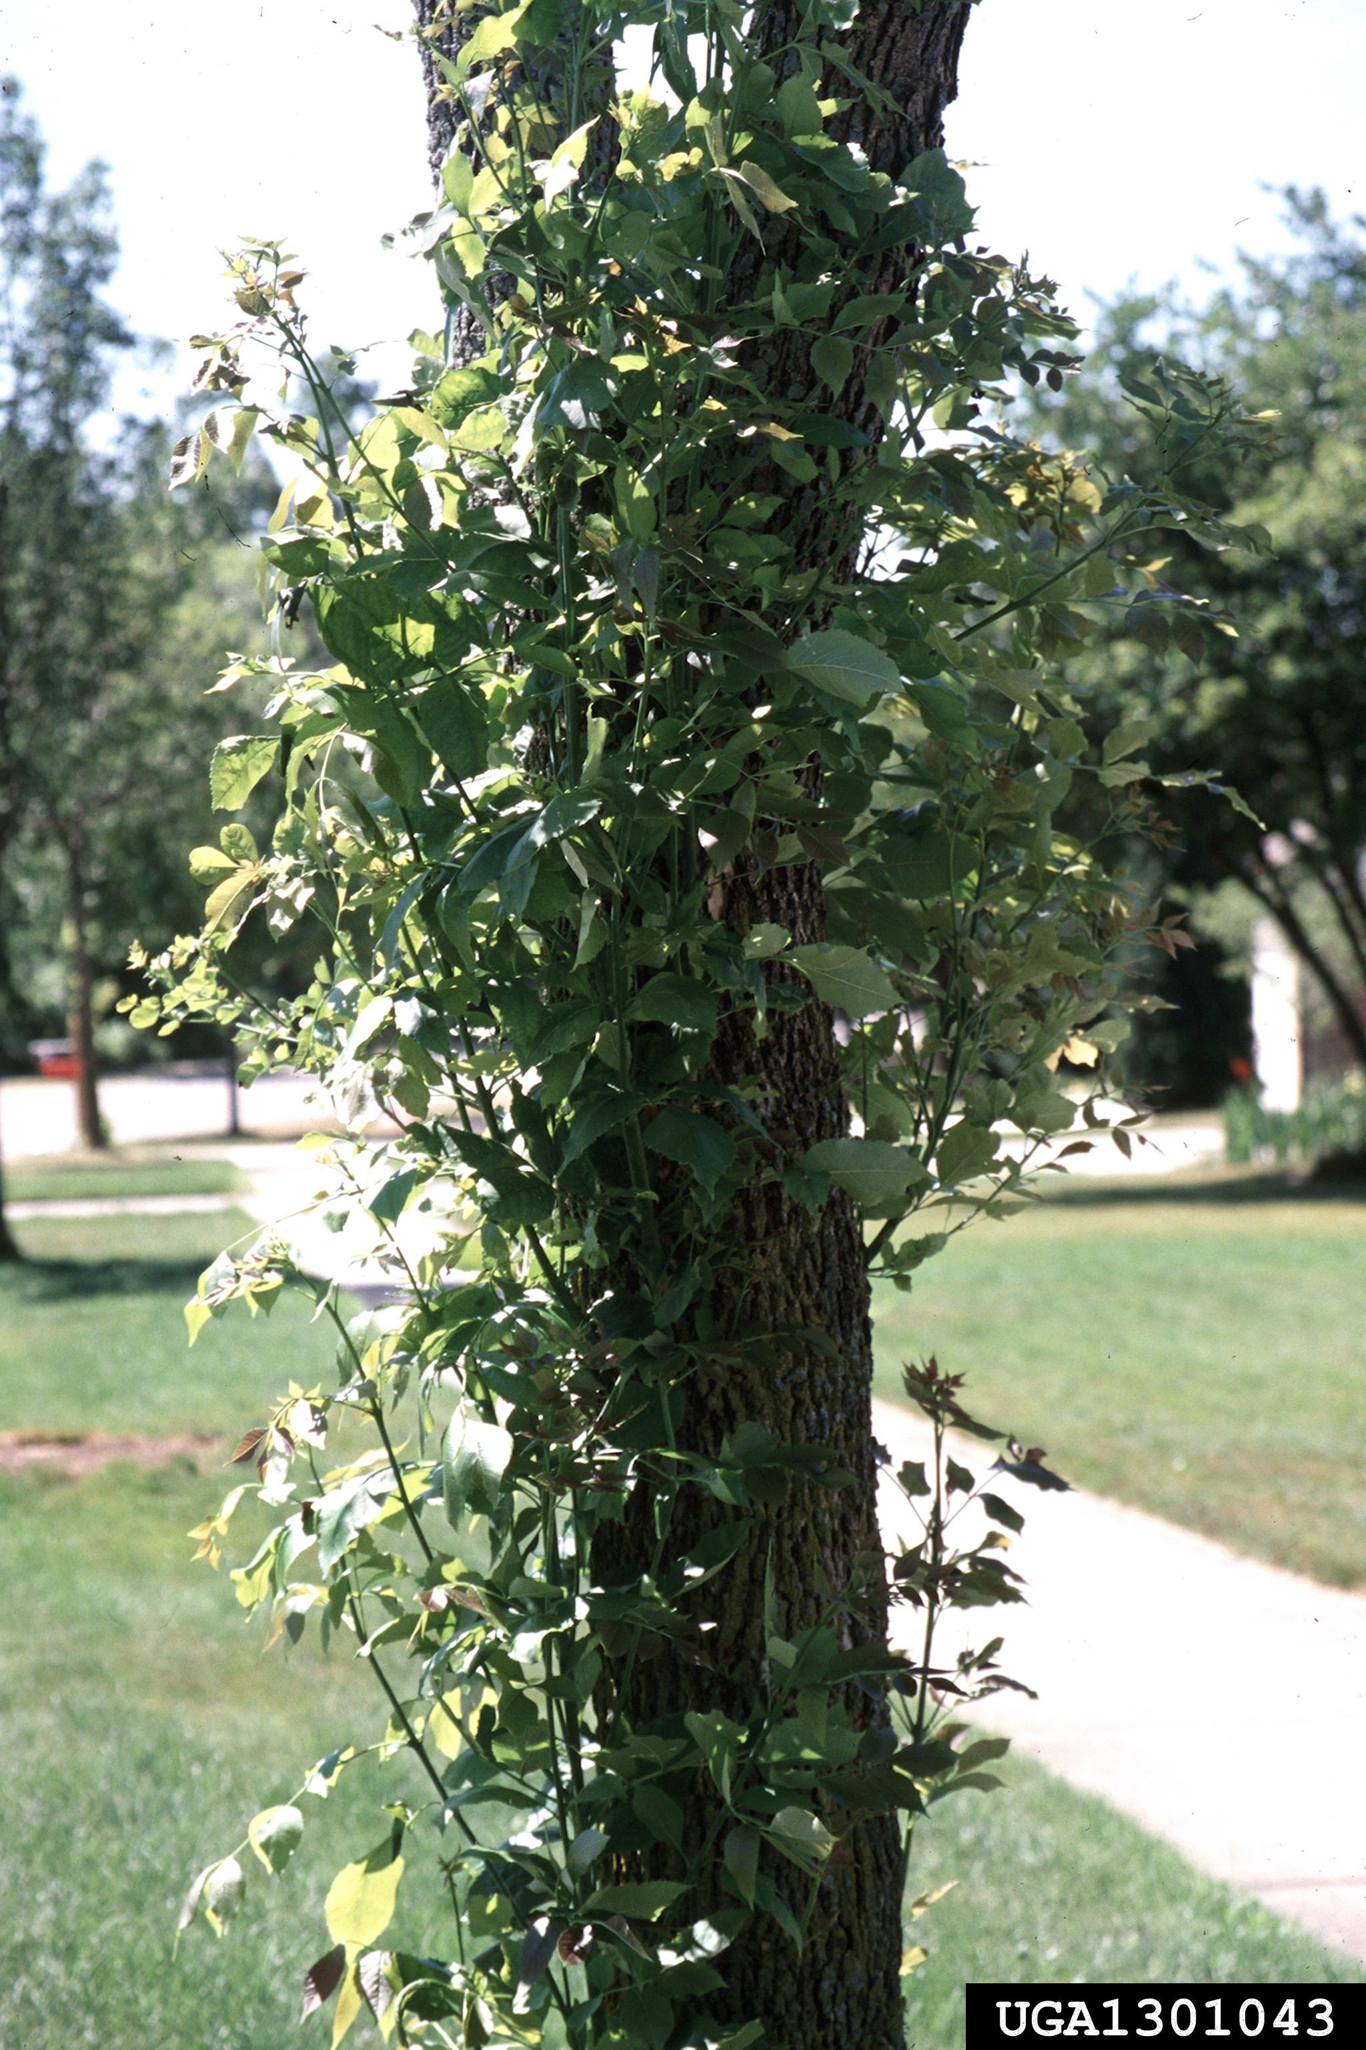
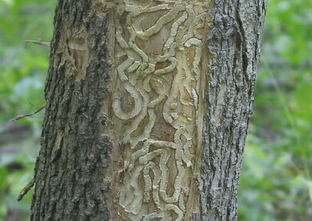
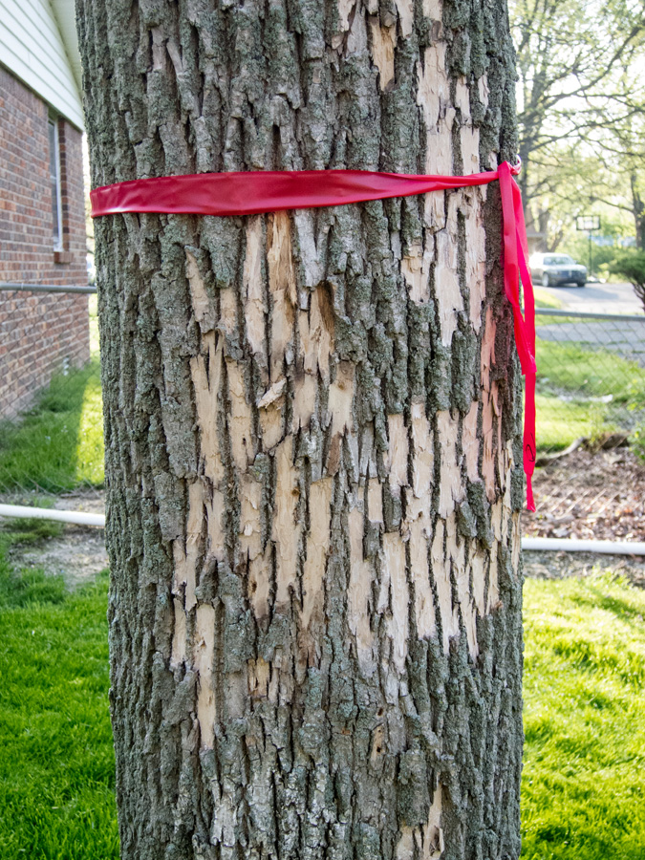
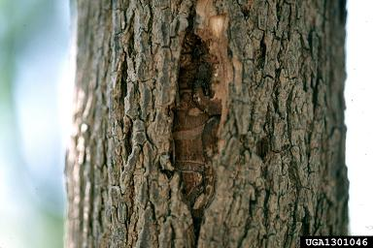
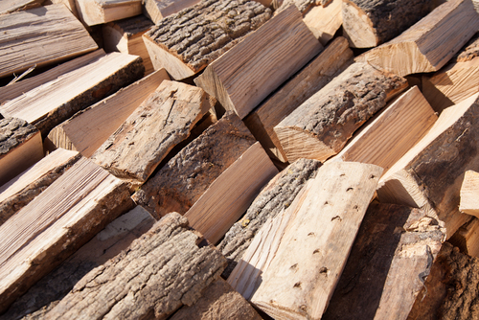
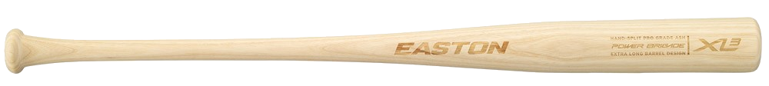
Fraxinus Spp. (Ash Tree)
Notes:
Ash trees (Fraxinus spp.) are an economically important source of wood in the United States
ADVANCE
with uses in furniture, firewood, and even baseball bats.
EAB are able to spread rapidly and continue to attack ash trees because there is no control on their population.
Woodpeckers and a few types of wasps will prey on them, but not enough to make a significant impact against their numbers.
Also, ash trees have not been able to develop a resistance to the EAB because of how fast they have spread and how quickly they can kill a tree.
The larvae bore through the vascular tissue of the trees (phloem), which cuts off the nutrient supply from the roots to upper portions of the tree. An infected tree will die within 2-4 years after the initial infestation, depending on how many EAB are living inside.
ADVANCE
There are warning signs for an Ash tree in distress. These include a thinning crown as nutrients are cut off from the boring larvae. This process begins with the top 1/3 of the canopy and continues until the tree is bare.
ADVANCE
Epicormic shoots grow from the roots and the tree trunk with leaves much larger than normal. This isn’t always a sign of EAB on it’s own, trees under stress will stop repressing the gene that causes epicormics shoots, but when combined with one or more other symptoms it almost always means EAB infection.
ADVANCE
The bark can split due to callous tissue formation, much like a scar on the tree. When these splits occur they expose the larvae gallery.
ADVANCE
And you can see the larvae gallery shows unique s-patterns within the vascular tissue of the tree, filled with sawdust and larvae excrement.
ADVANCE
And finally there may be damage to the bark, known as bark flecking, due to increased woodpecker and rodent activity attempting to get at the larvae under the tree bark.

Slide 11
Quarantines and Firewood Regulations in Minnesota
Issued as an extension of the USDA APHIS Quarantine
Minnesota Statues Section 18G.06 (2008)
No wood can be moved outside of quarantine unless it is MDA/USDA approved
DNR approved firewood can be moved within a quarantine area
When a county is quarantined, the MDA will begin mitigation planning
Traps
Bio controls (wasps and woodpeckers)
Insecticides
Thinning
Early Detection is extremely important to slowing their spread!
Notes:
- MN is able to avoid having a statewide quarantine by instituting quarantines at the county level
MDA approved firewood gets heated in a USDA approved kiln where wood is required to maintain an internal temperature of at least 60° C (140° F) for a period of at least 60 minutes
Branch sampling is also performed in high risk areas (predicted by model). 35 branches sampled per site.

Slide 12
VGI – “Humans as Sensors”
VGI – Volunteered Geographic Information
Defined by Michael Goodchild as using technology to “create, assemble, and disseminate geographic information provided voluntarily by individuals”
The MDA does not have enough staff to monitor all risk areas
They host workshops to train citizens how to identify and report sightings
“Arrest The Pest”
The MDA is encouraging VGI to help with early detection
Web GIS can be used to facilitate VGI

Slide 13
Web and Mobile GIS
Along with the evolution of the Web 2.0 came an explosion of Web based GIS Services
Advantages of Web GIS
Does not require any software for the end user
Can facilitate editing in real time from multiple sources
Client – Server interaction
Can be consumed by any client that can make HTTP Requests
Browser
Mobile Device (smart phones, tablets)
Programming languages (Python, Java, C#, etc)

Slide 14
How to Promote VGI for EAB Early Detection?
My Solution: Develop a mobile application
Virtually all adult citizens in Minnesota have access to a smart phone
Target Platforms?
Android - ~71% market share
iOS - ~23% market share
Why Native Application over Web application?
Better performance
Full access to device capabilities
Push notifications, device sensors, local storage
More secure
I do not have a web server to host a web application from

Slide 15
The ArcGIS Runtime
In order to leverage the full capabilities of the ArcGIS platform in a native mobile application, the ArcGIS Runtime Software Development Kits (SDKs) are required.
Built on a Runtime Core
Small, high performance C++ library
Has its own geometry engine
Renders map graphics on the device natively with GPU Accelaration (OpenGL and DirectX depending on platform)
Compiled natively onto each platform
Desktop, iOS, Android

Slide 16
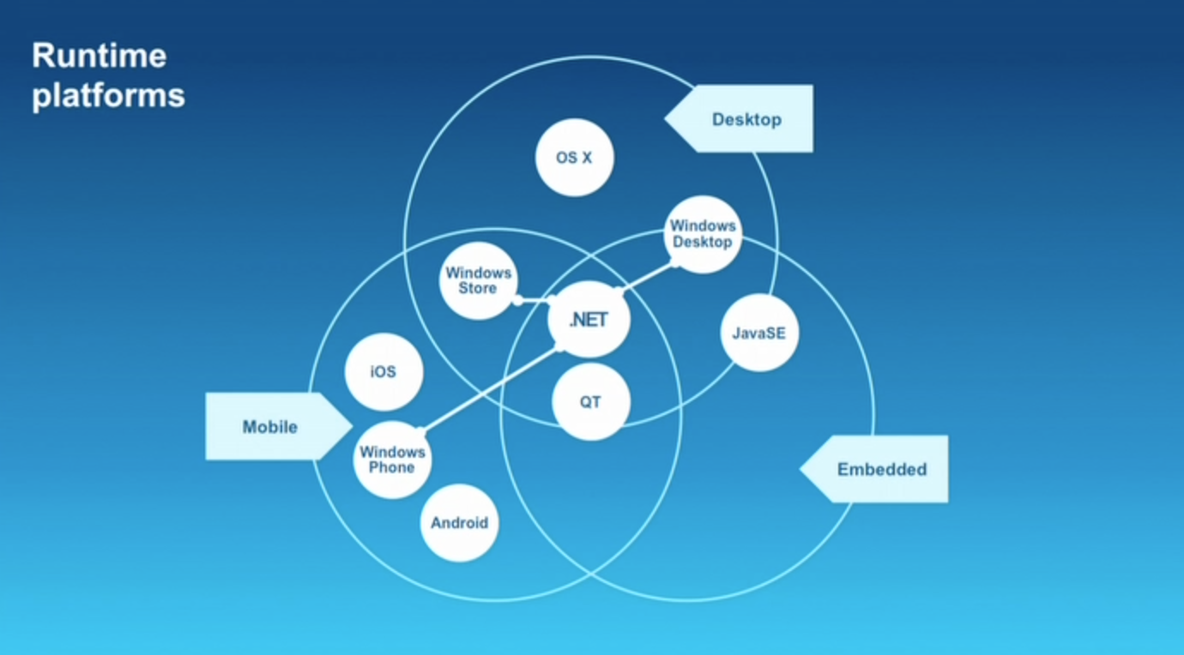

Slide 17
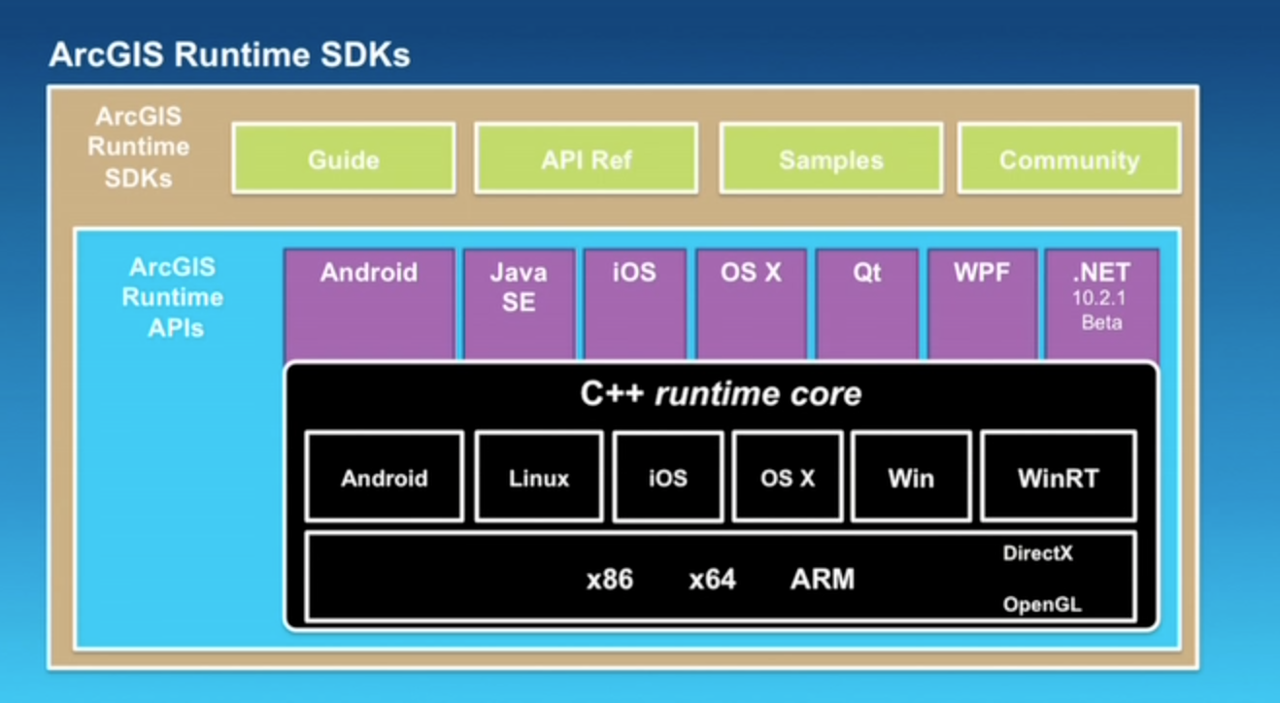

Slide 18
Goals of Application
Allow user to report sighting
Use device GPS to capture location
Use device camera to take photos (required for all sightings)
Provide a simple identification guide (EAB and Ash trees)
Incorporate a map view where the user can view existing sightings and MDA EAB GIS data
Automatically generate an email to send to the MDA’s Arrest The Pest email account
Add photos as attachments
Send push notifications to all users when new sightings are reported
Add authentication so the MDA can login to edit data
Can use fingerprint ID on iOS – Very cool!

Slide 19
Application Development
iOS – App is currently 70% complete. Built with Apple’s new Swift programming language and the Xcode Integrated Development Environment (IDE)
ArcGIS Runtime SDK for iOS was added to the project via CocoaPods
Android – Currently 40% complete. Built with the Java programming language and Android Studio IDE.
ArcGIS Runtime SDK was added to the project using a maven bintray
Both apps required special user permissions:
Camera/media access
GPS/location services
Internet access
In Android, permissions to use OpenGL for GPU acceleration had to be explicitly added.

Slide 20
Demo

Slide 21
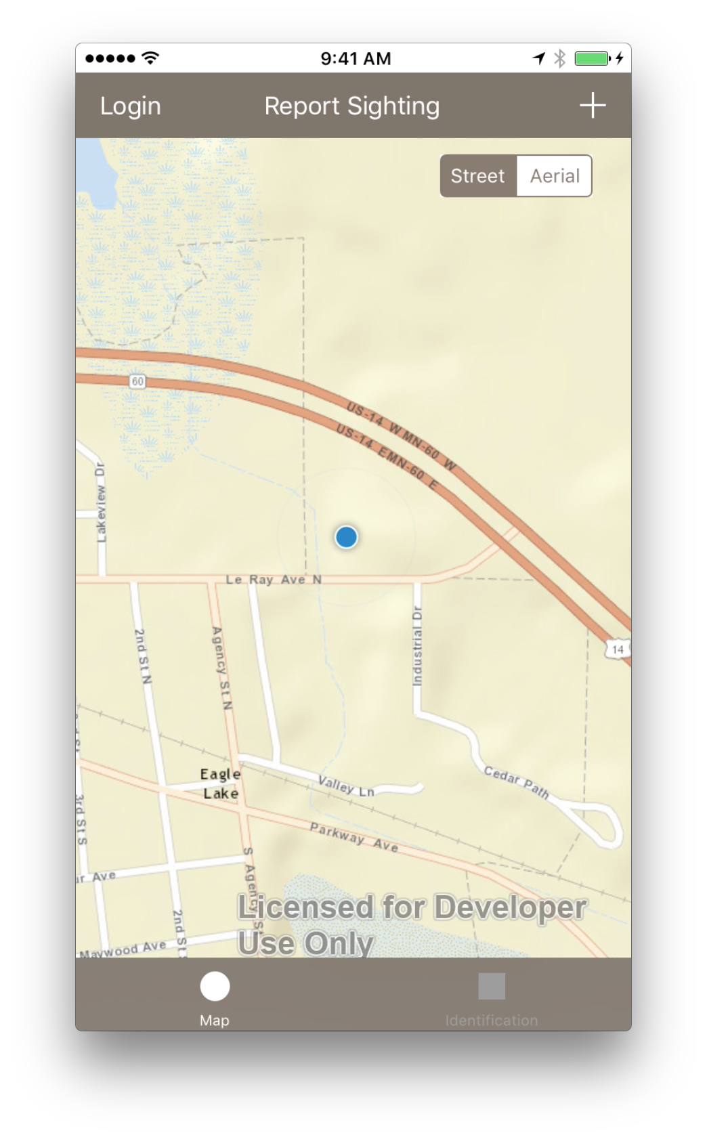
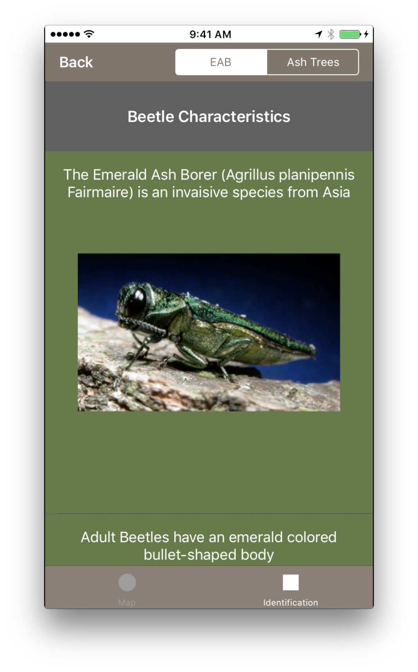
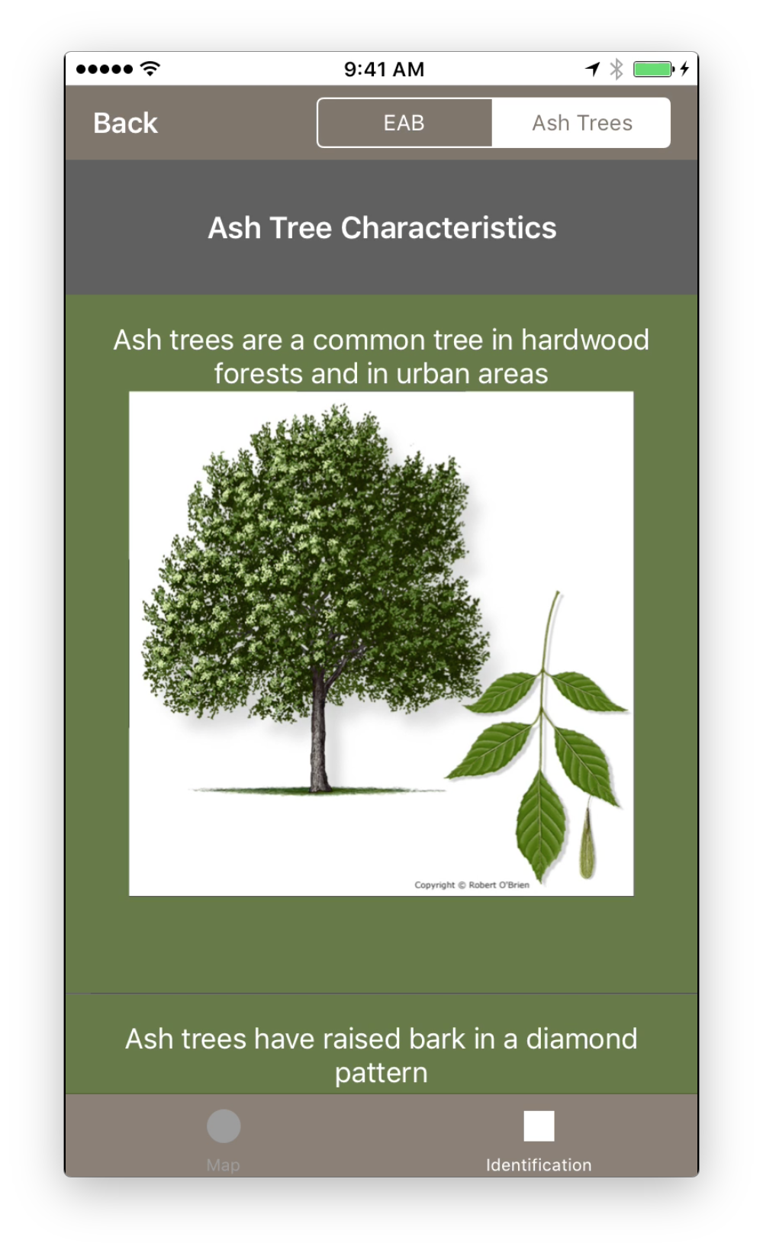

Slide 22
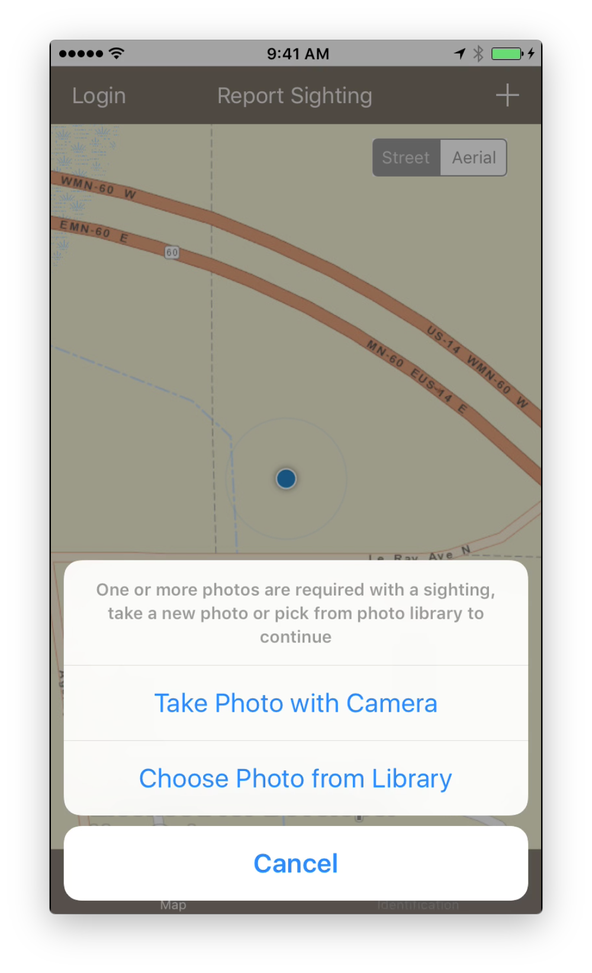
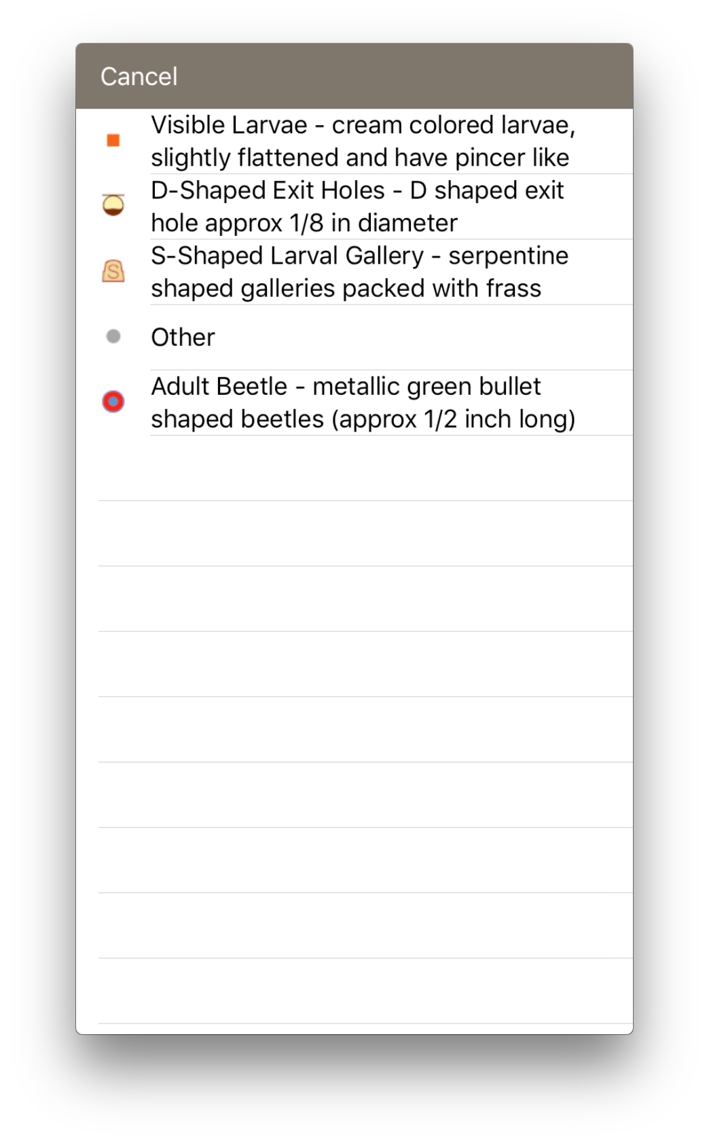
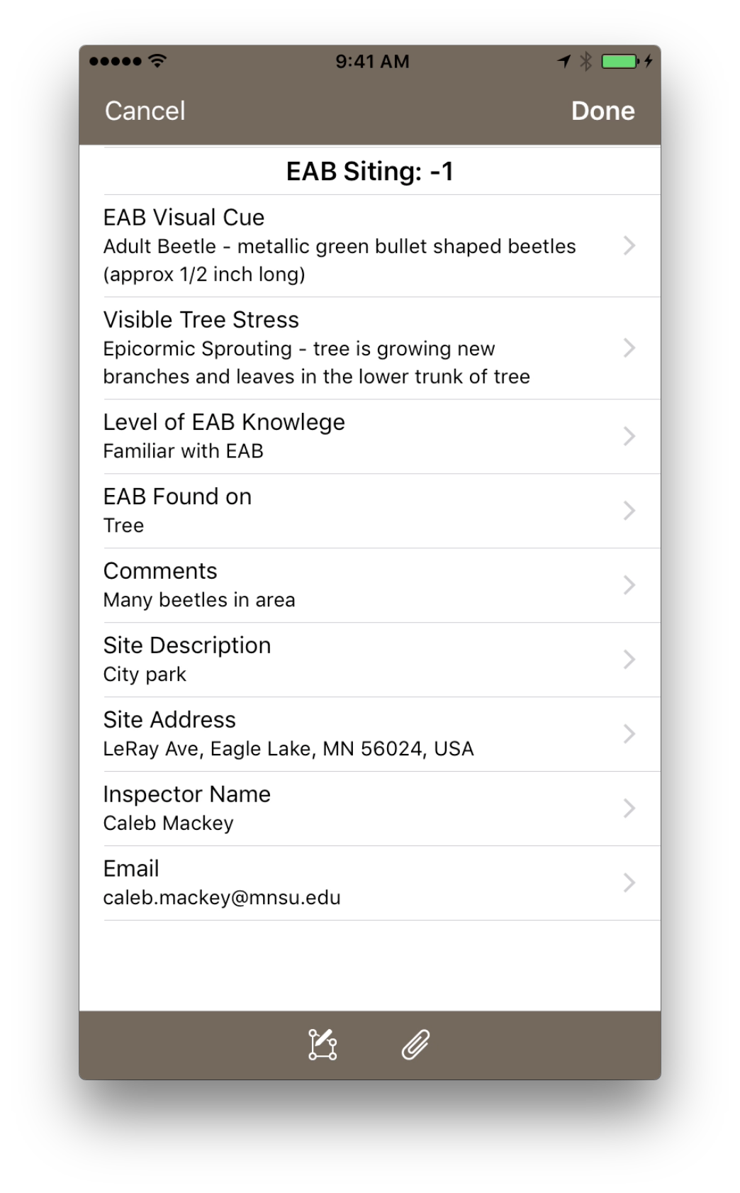

Slide 23
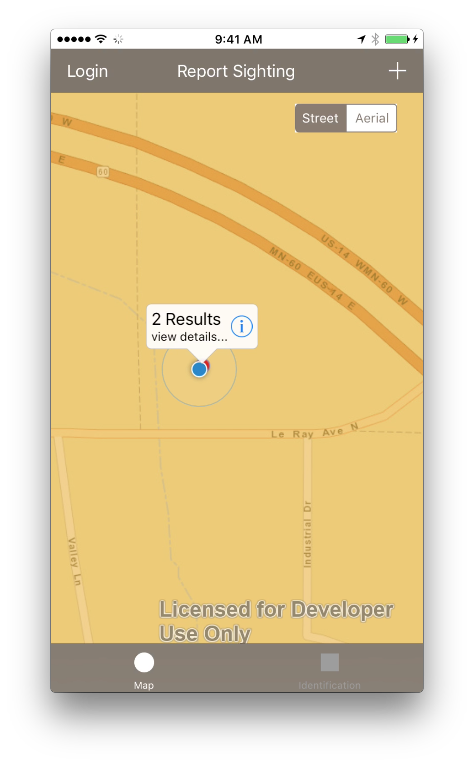
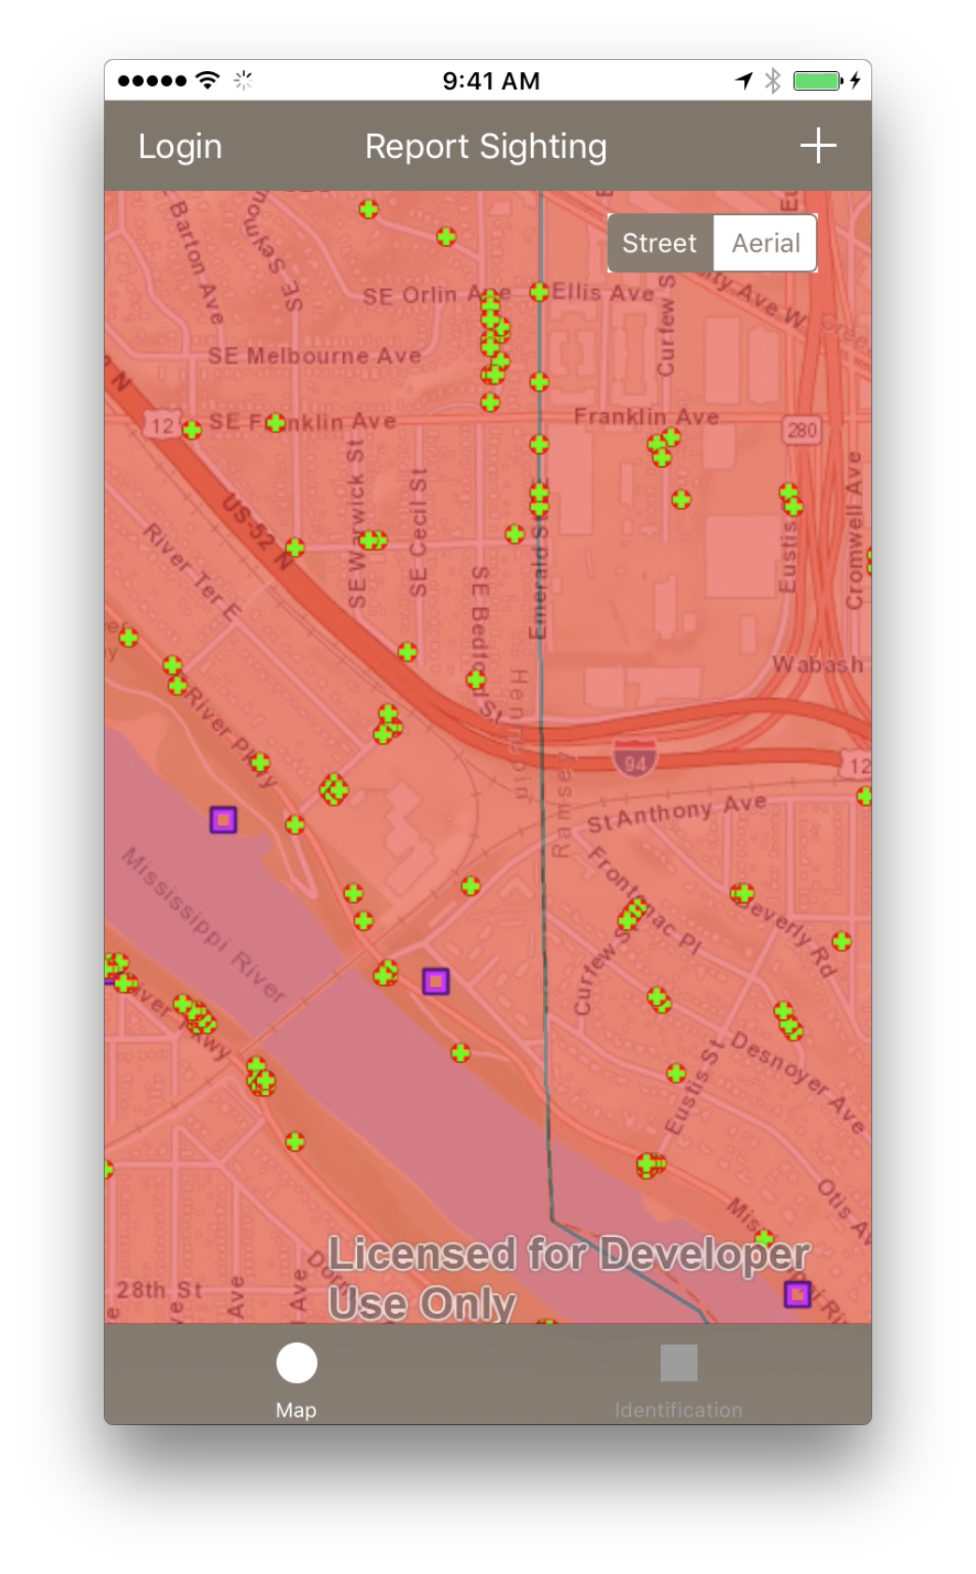
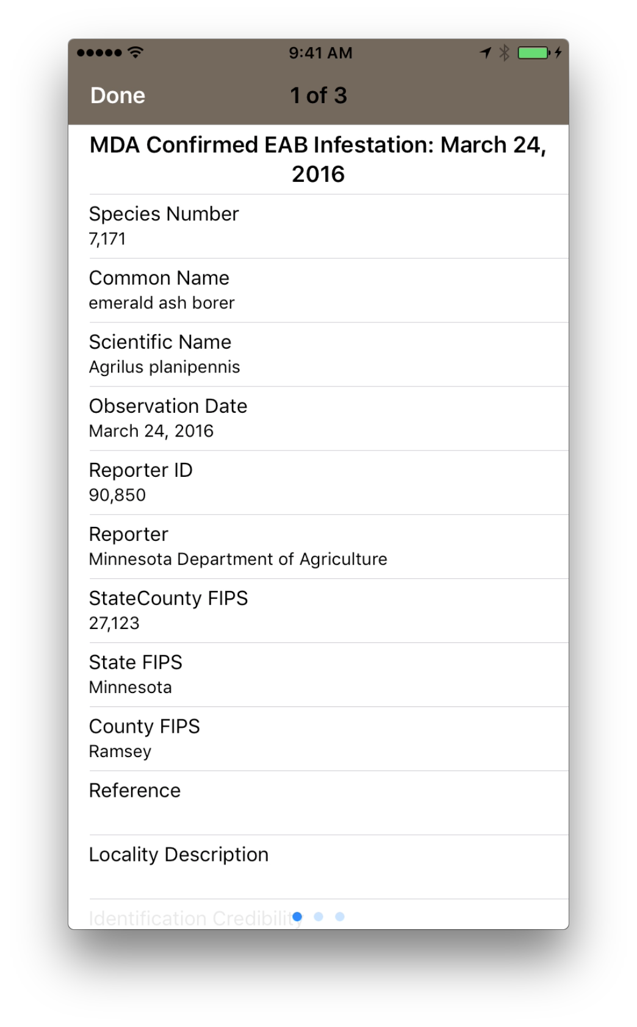

Slide 24
